Slide 1
CCHS

Slide 2
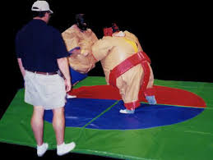
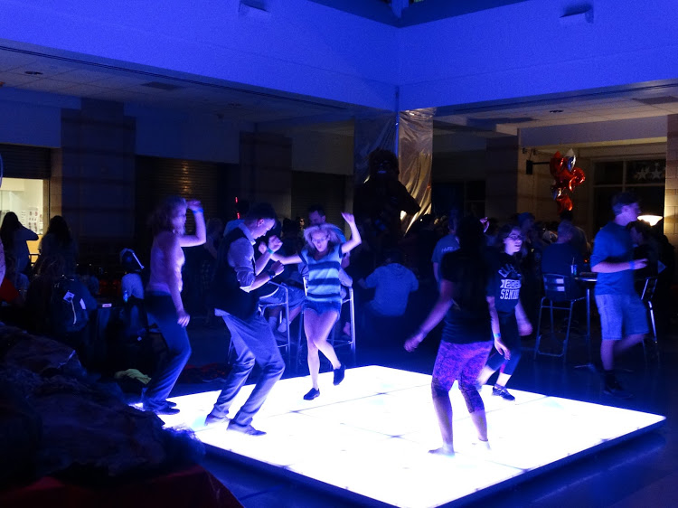
Night of good clean fun at the school immediately following graduation. Times are approximately 11 p.m. – 6 a.m.
There will be food, fun, inflatables, dancing, prizes and more!
Listen for more information to come!
We will need help raising funds to make this happen! We have lots of opportunities but need YOU to help! Let’s make this first Project Graduation the BEST Project Graduation!!

Slide 3
Interested in being a PG19 sponsor? We would love to have you or your business as a sponsor! Click on the link below for our sponsor letter!
Join our Remind to receive all the reminders!
Enter this number 81010
Text this message @pwoodle
Like our Facebook page
CCHS c/o 2019
https://docs.google.com/document/d/1f7Cf3n4ldSDYhZSTPj290bXcQxqUtiyD1ElnXr2U3pg/edit

